Slide 1

SQL Interview Questions
1st Edition
Wei Jiang
2022.06

Slide 2
1. What are data types in SQL?
Character types
  Character (CHAR)
  Character varying (VARCHAR)
  Character large object (CLOB)
National character types
  National character (NCHAR)
  National character varying (NCHAR VARYING)
  National character large object (NCLOB)
Binary types
  Binary (BINARY)
  Binary varying (VARBINARY)
  Binary large object (BLOB)

Slide 3
1. What are data types in SQL? (cont’d…)
Numeric types
  Exact numeric types (NUMERIC, DECIMAL, SMALLINT, INTEGER, BIGINT)
  Approximate numeric types (FLOAT, REAL, DOUBLE PRECISION)
  Decimal floating-point type (DECFLOAT)
Datetime types (DATE, TIME, TIMESTAMP)
Interval type (INTERVAL)
Boolean
XML
JSON

Slide 4
2. What is the difference between SQL and NoSQL?
SQL is used in the relational-based database; SQL stands for Structured Query Language
Examples of relational DB software
Amazon Aurora, Greenplum, MariaDB, Microsoft SQL Server, SQL Azure (cloud-based), MySQL, Netezza, Omnis Studio, Oracle, PostgreSQL, Snowflake Cloud Data Warehouse, SQLite
NoSQL is used in the non-relational database; NoSQL databases are increasingly used in big data and real-time web applications (web 2.0); not-only-SQL means that it also supports SQL-like query languages and more than SQL

Slide 5
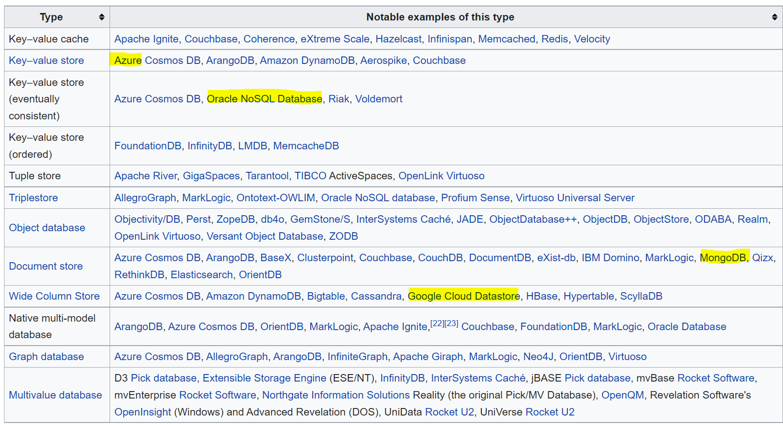
2. What is the difference between SQL and NoSQL? (Cont’d…)
Examples of non-relational database software:
Azure Cosmos DB, Amazon DynamoDB, MongoDB, Google Could Datasore

Slide 6
3. What is RDBMS?
Relational database management system
Database is an organized collection of data stored and accessed electronically. Small databases can be stored on a file system, while large databases are hosted on computer clusters or cloud storage.
Database management system (DBMS) is the software that interacts with end users, applications, and the database itself to capture and analyze the data.
Database models: relational databases (in the 1980s); non-relational databases (in the 2000s)

Slide 7
4. What are database languages?
Data control language (DCL): controls access to data
Data definition language (DDL): create, alter, drop, truncate
Data manipulation language (DML): select, insert, update, delete
Data query language (DQL): allows searching for information and computing derived information

Slide 8
5. How to standardize a relational-based data structure?
Normalization:
Process of organizing data into multiple tables to reduce redundancy and prevent inconsistencies
1NF: Eliminate repeating groups
2NF: Eliminate redundant data
3NF: Eliminate columns not dependent on key field
4NF: Isolate independent multiple relationships
5NF: Isolate semantically related multiple relationships

Slide 9
6. What is an index? What are types of indexes?
Index allows the database to find data fast without reading the whole table;
It is used to search for information that meets a certain criterion in the database.
Example: B-Tree Index
Student_ID | Student_Nm | Subject
1 | Sally | Mathematics
2 | Molly | Physics
3 | AIlie | Economics
…… | …… | ……
300 | Ridley | Anthropology
0-300
0-100
101-200
201-300
0-30
31-60
61-100
101-130
131-160
161-200
201-230
231-260
261-300

Slide 10
Different Types of Indexes:
Clustered Index: Primary index of the table and defines how the records are stored on disk
e.g. primary key is item_id
Non-clustered Index: contains key values that point to the clustered index position of a record
e.g. name value is item_name; create non-clustered index on the item_name
CREATE INDEX idx_menu ON menu(item_name) USING tree;
Search for an item on the menu named “latte”:
select * from menu where item_name = “latte”;

Slide 11
Different Types of Indexes: (cont’d.…)
Row-stored index:
  Clustered index
  Non-clustered index
Column-stored index:
  An in-memory columnstore index stores and manages data by using column-based data storage and column-based query processing;
  Work well for data warehousing workloads that primarily perform bulk loads and read-only queries

Slide 12
Different Types of Indexes: (cont’d.…)
B-tree: most common type of index; used for equality and range queries; clustered index
Hash: used for equality; hash function for mapping arbitrary length data to a fixed-size string (f(x)=y)
Bitmap: used for inclusion
Specialized indexes, for geo-spatial or user-defined indexing strategies
Example: Hash index
String | Hash Value
Latte | 06e0915hc623d01bc2cu
Cappuccino | 05f1715kd732e02cf3dw
Espresso | 02g2363le321g05dh5eo

